Slide 1

Topic for the class: Preamble of the Course, Overview of the Course, Course Objectives, Course Outcomes, Communication model & tasks of communication model Date & Time :05/09/2022 & 09:00AM to 09:50AM
T.V.Suri Apparao
Assistant Professor
Department of EECE
GITAM Institute of Technology (GIT)
Visakhapatnam – 530045
Email: vtanakal@gitam.edu

Slide 2
A majority of computer applications require communication of data from one device to another. As such, this course deals with data communications, including conversion of data into a signal, propagation of the signal through a medium and conversion of the signal back into data. Proper communication also requires the two communicating devices to follow a common protocol. This course covers the concepts of layered network architecture, properties of different transmission media and data communication principles. Various signal encoding techniques and their merits and demerits are taught, together with basic error and flow control techniques and multiplexing.
Preamble

Slide 3
Why study Data Communications ?
Data communications refers to the transmission of digital data between two or more computers.
When we communicate, we are sharing information. This sharing can be local or remote.
Between individuals, local communication usually occurs face to face, while remote communication takes place over distance.
Success in any industry, business, science or education has greatly depends upon informational/data and intelligence.
In early 1970’s there is no efficient way to share data, they have to copy physically onto a floppy disk and reload into another device, even if the device is as close as next device.

Slide 4
Later with the advent of digital data communications, the task has become easier, as all devices are able to connect to each other.
Defining Data Communication : It is a exchange of data between two devices via some form of transmission medium, such as a wire.

Slide 5
Contd..
Advantages :
a) People could communicate and share information virtually
instantaneously across the entire globe, therefore one could
make faster decisions.
b) Safe and Stable data exchange environment.
c) Live video conferences.
d) Instant messaging .
e) Resource sharing such as printers and storage devices.
f) Exchange of information by means of e-Mails
g) Information sharing by using Web or Internet.

Slide 6
Syllabus
Unit I: Data communication, Data networking and the Internet: A communication model, data communications, networks, the Internet. Protocol Architecture: Need for protocol architecture, TCP/IP protocol architecture, OSI model, TCP/IP Vs OSI model.
Unit II: Data transmission: Concepts and terminology, analog and digital data transmission, transmission impairments, channel capacity. Transmission Media: Guided and unguided
Unit III: Signal encoding techniques: Digital data to digital signals, digital data to analog signals, analog data to digital signals, analog data to analog signals.
Unit IV: Digital Data Communication Techniques: Asynchronous and synchronous transmission, types of errors, error detection techniques, error correction techniques (single bit)
Data link control protocols: Flow control, error control, high level data link control (HDLC) protocol.
Unit V: Multiplexing: Frequency division multiplexing, characteristics, synchronous time division multiplexing, characteristics. statistical time division multiplexing, characteristics.
Text Book(s): 1 William Stallings, Data and Computer Communications, 8/e, Pearson Education., 2013.
References:
1. Fred Harshall, Data Communications, Computer Networks and Open systems,4/e, Pearson Education, 2005.
2. Behrouz A Forouzan, Data Communications and Networking, 4/e, McGraw Hill, 2012.

Slide 7
Course Objectives and Course Outcomes
Course objectives:
Introduce the concepts of Data Communications and different models
Impart the characteristics of various transmission media.
Familiarize different analog and digital transmission techniques.
Expose the basic error control and flow control techniques.
Acquaint with static channel allocation using TDMA and FDMA.
Course outcomes:
At the end of the course, students will be able to
illustrate and summarize the OSI and TCP/IP network architectures(L2)
compare the properties of various transmission media(L2)
utilize error correction and detection techniques to detect or correct errors(L3)
analyze flow control schemes for data transmission(L4)
explain basic signal encoding and multiplexing techniques(L2)

Slide 8
Unit I: Data communication, Data networking and the Internet -
A communication model
data communications
Networks
Internet.
Protocol Architecture
Need for protocol architecture
TCP/IP protocol architecture
OSI model,
TCP/IP Vs OSI model.

Slide 9
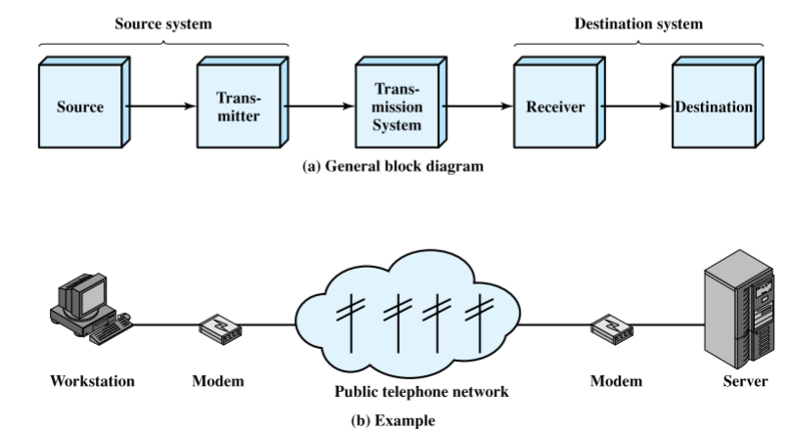
Communication model
The fundamental purpose of a communications system is the exchange of data between two parties.

Slide 10
key elements of the model
Source. This device generates the data to be transmitted; examples are telephones and personal computers.
Transmitter: Usually, the data generated by a source system are not transmitted directly in the form in which they were generated. Rather, a transmitter transforms and encodes the information in such a way as to produce electro-magnetic signals that can be transmitted across some sort of transmission system. For example, a modem takes a digital bit stream from an attached device such as a personal computer and transforms that bit stream into an analog signal that can be handled by the telephone network.
Transmission system: This can be a single transmission line or a complex network connecting source and destination.
Receiver: The receiver accepts the signal from the transmission system and converts it into a form that can be handled by the destination device. For example, a modem will accept an analog signal coming from a network or transmission line and convert it into a digital bit stream.
Destination: Takes the incoming data from the receiver.

Slide 11
A Communications Model Components
Source -→ Generates data to be transmitted
Transmitter -→ Converts data into transmittable signals
Transmission System -→ Carries data
Receiver -→ Converts received signal into data
Destination -→ Takes incoming data

Slide 12
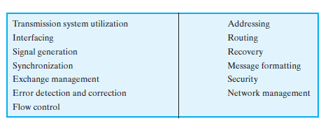
MODEM : . Modem takes a digital bit stream from an attached device such as a personal computer (PC) & transforms that bit stream into an analog signal that can be handled by the telephone network. Data Communications Tasks : . Key tasks that must be performed in a Data Communications system are,

Slide 13
.Transmission system Utilization – It refers to the need to make efficient use of transmission facilities that are typically shared among a number of communicating devices. . Interface - To communicate, a device must interface with the transmission system. .Signal generation - Once an interface is established , signal generation is required for communication. . Synchronization - In order to maintain Synchronization, the receiver must be able to determine when a signal begins to arrive and when it ends. . Exchange management - If data are to be exchanged in both directions over a period of time, the two parties must cooperate.

Slide 14
. Error detection and correction – required in circumstances where errors cannot be tolerated Eg : in Data Processing systems. . Flow control - required to assure that the source doesn’t overwhelm the destination by sending data faster than they can be processed and absorbed. . Addressing & Routing – When more than two devices share a transmission facility, a source system must indicate the identity of the intended destination. . Recovery - are needed in situations in which an information exchange, such as a database transaction or file transfer, is interrupted due to a fault somewhere in the system. The objective is either to be able to resume activity at the point of interruption or at least to restore the state of the systems involved to the condition prior to the beginning of the exchange.

Slide 15
. Message formatting – has to do with an agreement between two parties as to the form of the data to be exchanged or transmitted, such as the binary code for characters. . Security - It is important to provide some measure of security in a data communications system. . Network management - are needed to configure the system , monitor its status, react to failures and overloads & plan intelligently for future growth.

Slide 16
Fundamental Characteristics
The effectiveness of a data communications system depends on four fundamental characteristics:
1. Delivery: The system must deliver data to the correct destination. Data must be received by the intended device or user and only by that device or user. 2. Accuracy: The system must deliver the data accurately. Data that have been altered in transmission and left uncorrected are unusable.

Slide 17
Fundamental Characteristics
3. Timeliness: The system must deliver data in a timely manner. Data delivered late are useless. In the case of video and audio, timely delivery means delivering data as they are produced, in the same order that they are produced, and without significant delay. This kind of delivery is called real-time transmission. 4. Jitter: Jitter refers to the variation in the packet arrival time. It is the uneven delay in the delivery of audio or video packets. For example, let us assume that video packets are sent every 3ms. If some of the packets arrive with 3-ms delay and others with 4-ms delay, an uneven quality in the video is the result.

Slide 18
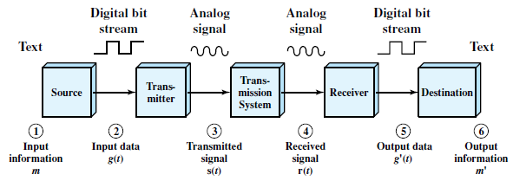
Data Communications Model : Fig : Simplified Data Communications Model

Slide 19
. The block diagram can be explained using electronic mail as an example . Let the input device and transmitter are components of a PC . The user of the PC wishes to send a message ‘m’ to another user . The user activates the electronic mail package on the PC & enters the message via the key board . We can view a sequence of bits(g) in memory . PC is now connected to some transmission medium such as LAN, DSL, etc . The i/p data are transferred to the transmitter as a sequence of voltage shifts g(t) . The transmitter is connected directly to the medium & converts the incoming stream g(t) into a signal s(t) suitable for transmission . The transmitted signal s(t) presented to the medium is subject to a number of impairments before it reaches the receiver

Slide 20
. The received signal r(t) may differ from s(t) . The receiver will attempt to estimate the original signal s(t) based on r(t) & its knowledge of the medium, producing a sequence of bits g!(t) . The destination system will determine if an error has occurred . This data will be given to the user via an o/p device such as printer/screen . The message m! will usually be an exact copy of the original message (m)

Slide 21
Data Flow: Transmission Modes
Communication between two devices can be
Simplex
Half-duplex
Full-duplex.

Slide 22
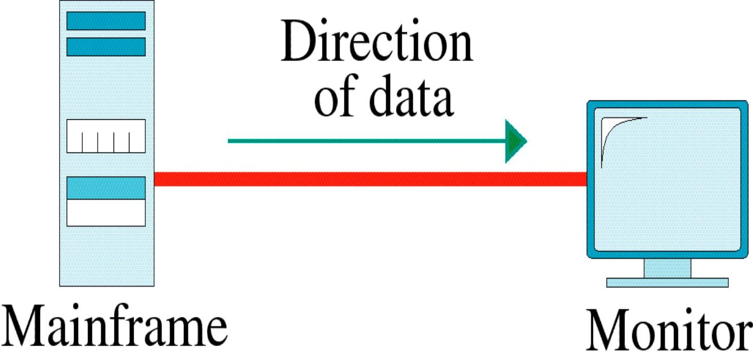
Simplex
In simplex mode, the communication is unidirectional, as on a one-way street. Only one of the two devices on a link can transmit; the other can only receive.
Keyboards and traditional monitors are examples of simplex devices. The keyboard can only introduce input; the monitor can only accept output.
The simplex mode can use the entire capacity of the channel to send data in one direction.

Slide 23
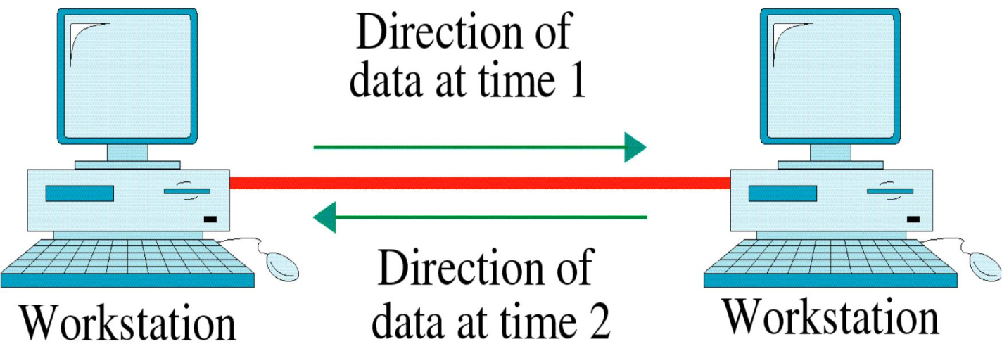
Half-Duplex
Half-Duplex: Each station can both transmit and receive, but not at the same
time. When one device is sending, the other can only receive and vice versa.
Example: One-lane road with two-directional traffic.
The half-duplex mode is used in cases where there is no need for communication
in both directions at the same time; the entire capacity of the channel can be utilized for each direction.

Slide 24
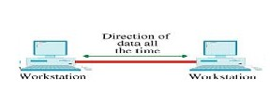
Full-Duplex
Full-Duplex: (Also called Duplex) Both stations can transmit and receive
simultaneously.
Example: 1) Two-way street with traffic flowing in both directions at the same time.
2) Telephone network
The full-duplex mode is used when communication in both directions is required
all the time. The capacity of the channel, however, must be divided between the two directions.

Slide 25
Network Attributes
A network is two or more devices connected through links.
A link is a communication pathway that transfers data from one device to another.
For visualization purposes, it is simplest to imagine any link as a line drawn between two points.
For communication to occur, two devices must be connected in some way to the same link at the same time.
There are two possible types of connections: point-to-point and multipoint.

Slide 26
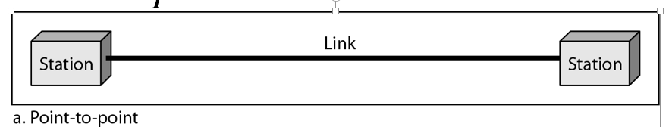
Line Configuration / Types of connections
Point-point Configuration:
It provides a dedicated link between two devices.
The entire capacity of the channel is reserved for transmission between those two devices.
Most point-to-point connections use an actual length of wire or cable to connect the two ends. When you change television channels by infrared remote control, you are establishing a point-to-point connection between the remote control and the television's control system.

Slide 27
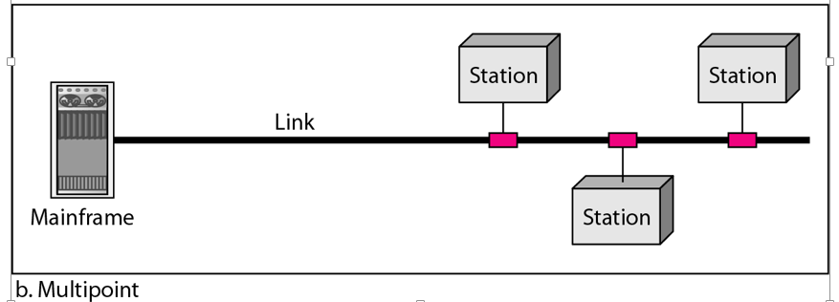
Line Configuration / Types of connections
Multipoint Configuration:
It is one in which more than two specific devices share a single link.
In a multipoint environment, the capacity of the channel is shared, either spatially or temporally. If several devices can use the link simultaneously, it is a spatially shared connection. If users must take turns, it is a timeshared connection.

Slide 28
Topologies
The term physical topology refers to the way in which a network is laid out physically.
Two or more devices connect to a link; two or more links form a topology.
The topology of a network is the geometric representation of the relationship of all the links and linking devices (usually called nodes) to one another.
Topology describes how the devices in a network are interconnected rather than their physical arrangement.

Slide 29
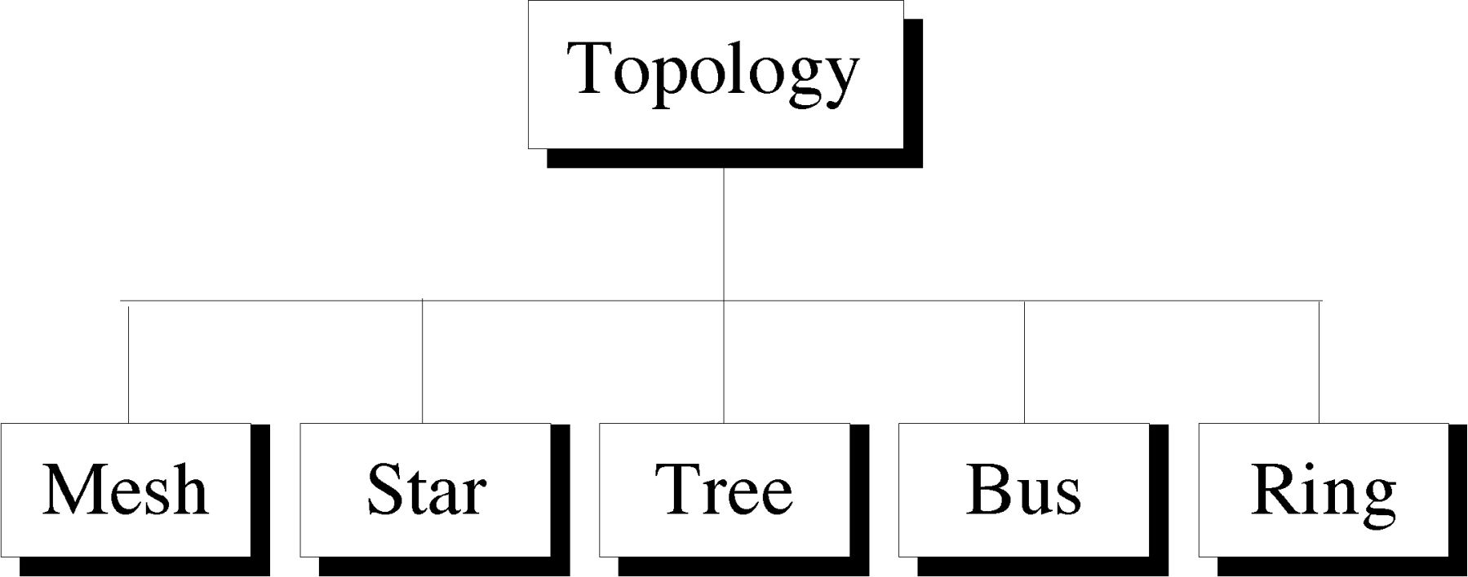

Slide 30
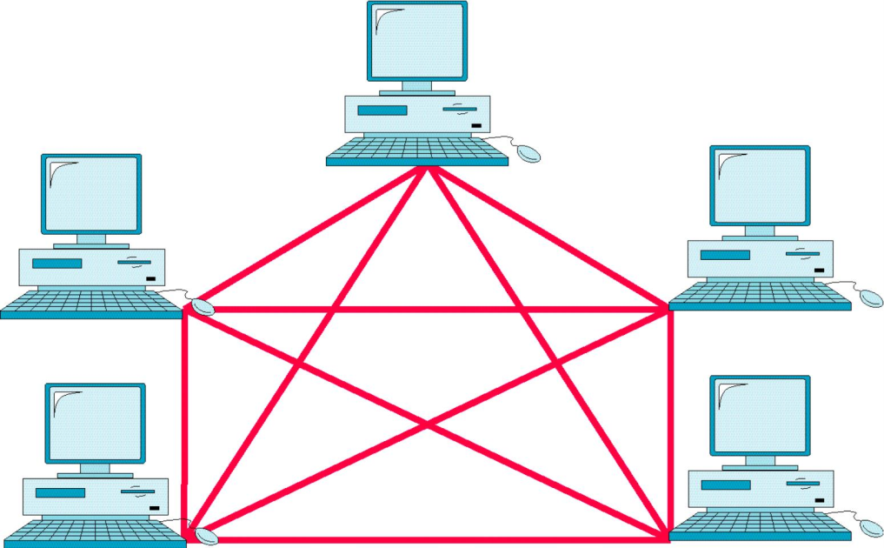
Mesh Topology
In a mesh topology, every device has a dedicated point-to-point link to every other device.
The term dedicated means that the link carries traffic only between the two devices it connects.
Total number of links n(n-1)/2
Every device must have (n-1) I/O ports

Slide 31
Mesh Topology
Advantages:
Traffic is eliminated
It is robust
Privacy and security
Fault identification and fault isolation is easy
Disadvantages:
Every device must be connected to every other devices -→ Installation and reconfiguration are difficult
More hardware is required to connect each link (I/O port and cable) -- >Expensive
Ex: connection of telephone regional offices

Slide 32
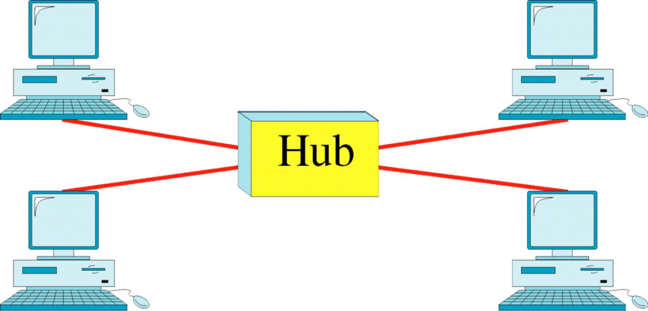
Star Topology
In a star topology, each device has a dedicated point-to-point link only to a central controller, usually called a hub. The devices are not directly linked to one another.
Unlike a mesh topology, a star topology does not allow direct traffic between devices. The controller acts as an exchange: If one device wants to send data to another, it sends the data to the controller, which then relays the data to the other connected device.
Each device requires only one link and one I/O port.

Slide 33
Star Topology
Advantages:
Less expensive than mesh topology
Less cabling needs
As compared to Bus topology it gives far much better performance
Fault identification and fault isolation is easy
Robustness- Failure of one node or link doesn’t affect the rest of network
Centralized management
Easy to connect new nodes or devices
Disadvantages:
If the Central Device which is the HUB goes down the entire network is affected

Slide 34
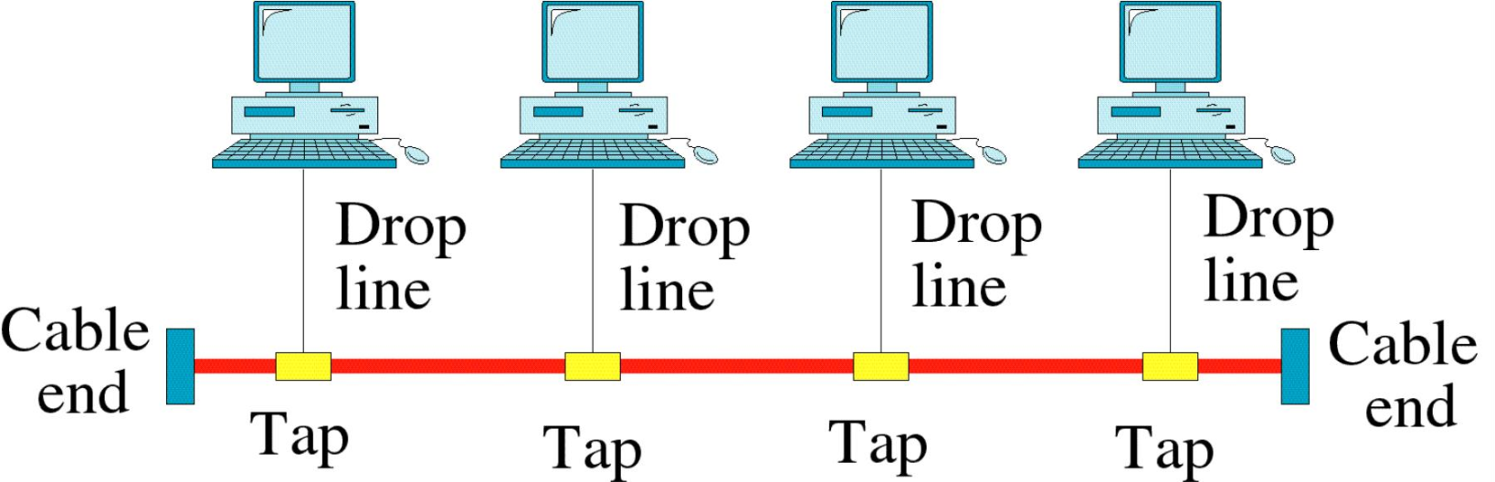
Bus Topology
A bus topology, is multipoint. One long cable acts as a backbone to link all the devices in a network.
Nodes are connected to the bus cable by drop lines and taps.
A drop line is a connection running between the device and the main cable.
A tap is a connector that either splices into the main cable or punctures the sheathing of a cable to create a contact with the metallic core.
As a signal travels along the backbone, some of its energy is transformed into heat. Therefore, it becomes weaker and weaker as it travels farther and farther. For this reason there is a limit on the number of taps a bus can support and on the distance between those taps.

Slide 35
Bus Topology
Advantages:
Easy to implement and extend
Easy of installation
Initially less expensive than other topologies
Cheaper compared to start topology
Requires less cable length than mesh and star topology.
Disadvantages:
Difficult to administer/troubleshoot.
Difficult to reconfiguration and fault isolation
Limited cable length and number of stations.
If there is a problem with the cable, the entire network goes down.
Maintenance costs may be higher in the long run.
Performance degrades as additional computers are added or on heavy traffic.
Low security (all computers on the bus can see all data transmissions).
One virus in the network will affect all of them (but not as badly as a star or ring network).
Proper termination is required.(loop must be in closed path).
If many computers are attached, the amount of data flowing causes the network to slow down.
Terminators are required at both ends of the backbone cable.
Not meant to be used as a stand-alone solution in a large building.

Slide 36
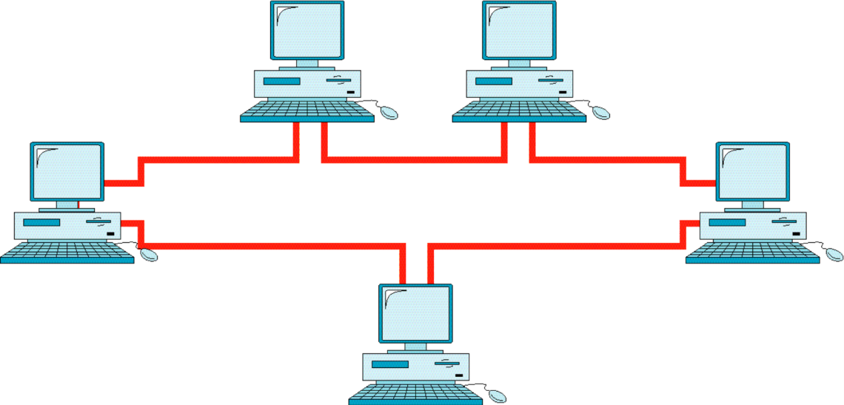
Ring Topology
In a ring topology, each device has a dedicated point-to-point connection with only the two devices on either side of it.
A signal is passed along the ring in one direction, from device to device, until it reaches its destination.
Each device in the ring incorporates a repeater. When a device receives a signal intended for another device, its repeater regenerates the bits and passes them along.

Slide 37
Ring Topology
Advantages:
Adding additional nodes has very little impact on bandwidth(require two connections)
Easy to install and configure
Equal access to devices no one computer will use all the bandwidth
Easy to detect faults and to remove parts
If one device does not receive a signal within a specified period, it can issue an alarm. The alarm alerts the network operator to the problem and its location
Disadvantages:
If any of the nodes fail then the ring is broken and data cannot be transmitted successfully.
Because all stations are wired together, to add a station you must shut down the network temporarily
In order for all computers to communicate with each other, all computers must be turned on.
Total dependence upon the one cable

Slide 38
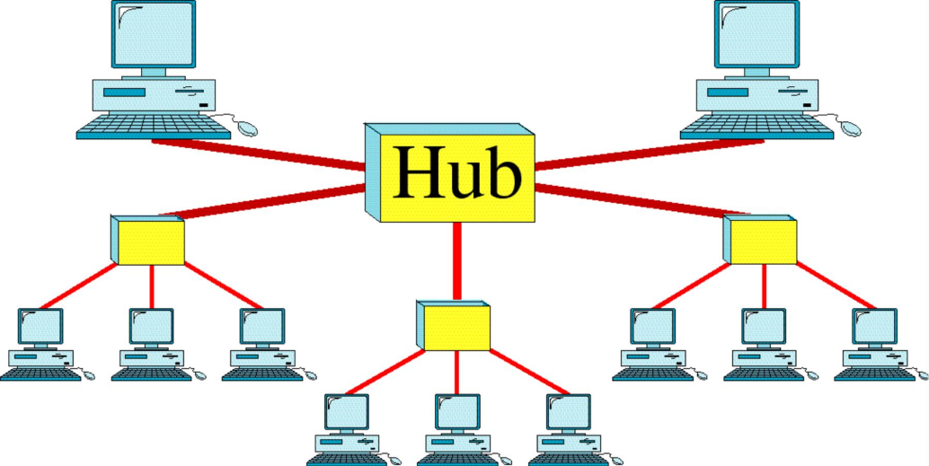
Tree Topology
Tree topology follows a hierarchical pattern whereby each level is connected to the next higher level in a symmetrical pattern.
It connects multiple star topologies to other star topology network.
Tree topology is the best when the network is large and not for a small network because it is a waste of cables to use it.

Slide 39
Tree Topology
Advantages:
Point-to-point wiring for individual segments.
Supported by several hardware and software venders.
It is an extension of Star and bus Topologies, so in networks where these topologies can't be implemented individually for reasons related to scalability, tree topology is the best alternative.
Expansion of Network is possible and easy.
Here, we divide the whole network into segments (star networks), which can be easily managed and maintained.
Easy to detect a faulty device.
Easy to expand a network.
Error detection and correction is easy.
Each segment is provided with dedicated point-to-point wiring to the central hub.
If one segment is damaged, other segments are not affected.
Disadvantages:
As more and more nodes and segments are added, the maintenance becomes difficult.
Scalability of the network depends on the type of cable used
More difficult to configure as compared to other topologies.
Fault in the backbone affects the entire network.
More expensive than other topologies.
Overall length of each segment is limited by the type of cabling used.

Slide 40
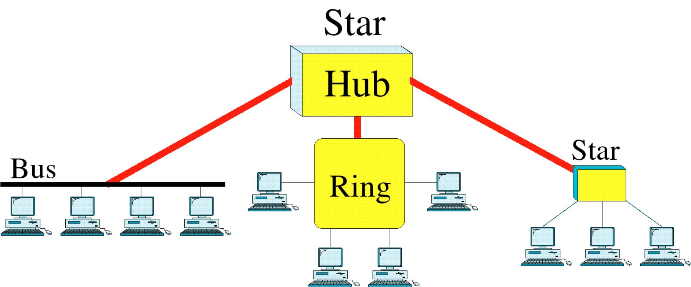
Hybrid Topology
A network can be hybrid. For example, we can have a main star topology
with each branch connecting several stations in a bus topology as shown in Figure.

Slide 41
Hybrid Topology
Advantages:
Reliable : Unlike other networks, fault detection and troubleshooting is easy in this type of topology. The part in which fault is detected can be isolated from the rest of network and required corrective measures can be taken, WITHOUT affecting the functioning of rest of the network.
Scalable: Its easy to increase the size of network by adding new components, without disturbing existing architecture.
Flexible: Hybrid Network can be designed according to the requirements of the organization and by optimizing the available resources. Special care can be given to nodes where traffic is high as well as where chances of fault are high.
Effective: Hybrid topology is the combination of two or more topologies, so we can design it in such a way that strengths of constituent topologies are maximized while there weaknesses are neutralized. For example we saw Ring Topology has good data reliability (achieved by use of tokens) and Star topology has high tolerance capability (as each node is not directly connected to other but through central device), so these two can be used effectively in hybrid star-ring topology

Slide 42
Hybrid Topology
Disadvantages:
Complexity of Design: One of the biggest drawback of hybrid topology is its design. Its not easy to design this type of architecture and its a tough job for designers. Configuration and installation process needs to be very efficient.
Costly Hub: The hubs used to connect two distinct networks, are very expensive. These hubs are different from usual hubs as they need to be intelligent enough to work with different architectures and should be function even if a part of network is down.
Costly Infrastructure: As hybrid architectures are usually larger in scale, they require a lot of cables, cooling systems, sophisticate network devices, etc.

Slide 43
Network Criteria
1. Performance: It can be measured in many ways, including transit time and response time.
Transit time is the amount of time required for a message to travel from one device to another device
Response time is the elapsed time between an inquiry and a response.
The performance of a network depends on a no. of factors:
The no. of users
The type of transmission medium
The capabilities of the connected network
The efficiency of the software
2. Reliability: It can be measured by frequency of failure, the time it takes a link to recover from a failure, and the network’s robustness in a catastrophe.
3. Security: Network security issues include protecting data from unauthorized access and viruses.

Slide 44
Categories of Networks
Local Area Networks (LANs)
Short distances
Designed to provide local interconnectivity
Wide Area Networks (WANs)
Long distances
Provide connectivity over large areas
Metropolitan Area Networks (MANs)
Provide connectivity over areas such as a city, a campus

Slide 45
Local Area Network (LAN)
LAN is usually privately owned and links the devices in a single office, building or campus.
LANs are distinguished from other networks by 3 characteristics
Size
Transmission technology
Topology
LANS come in a no.of different configurations. The most common are-Switched LAN & Wireless LAN.

Slide 46
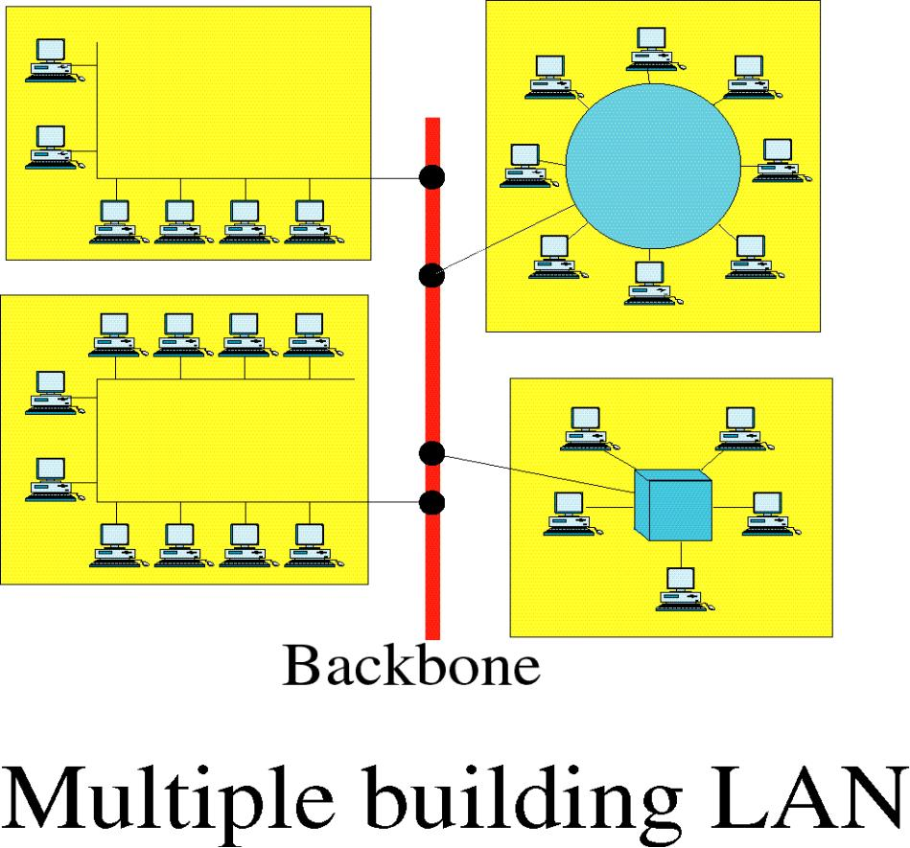
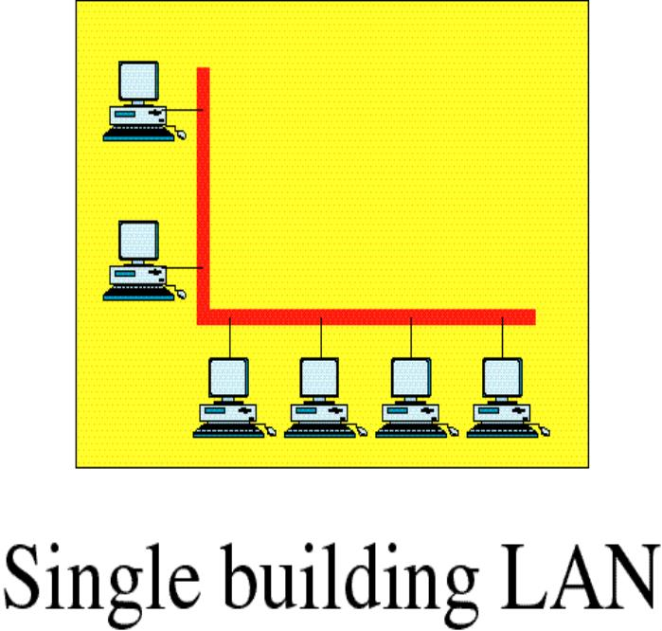
Local Area Network

Slide 47
Local Area Network
Smaller scope
Office, Building, Campus
Usually owned by the same organization that owns the attached devices
Internal data rates are high
10Mbps → 100Mbps → 1Gbps → 10Gbps
Wireless LANs become more and more popular
Data rates of wireless LANs are increasing: 11Mbps → 54Mbps → hundreds of Mbps

Slide 48
Metropolitan Area Network (MAN)
A Man is a network with a size between a LAN and a WAN.
MAN is support for both data and voice. It is connected either privately/publicly.
It normally covers the area inside a town or a city.
A MAN is intended to provide the required capacity at lower cost and greater efficiency.
Examples- Telephone cable and Television cable.
Key aspect is there is a broadcast medium to which all computers are attached.

Slide 49
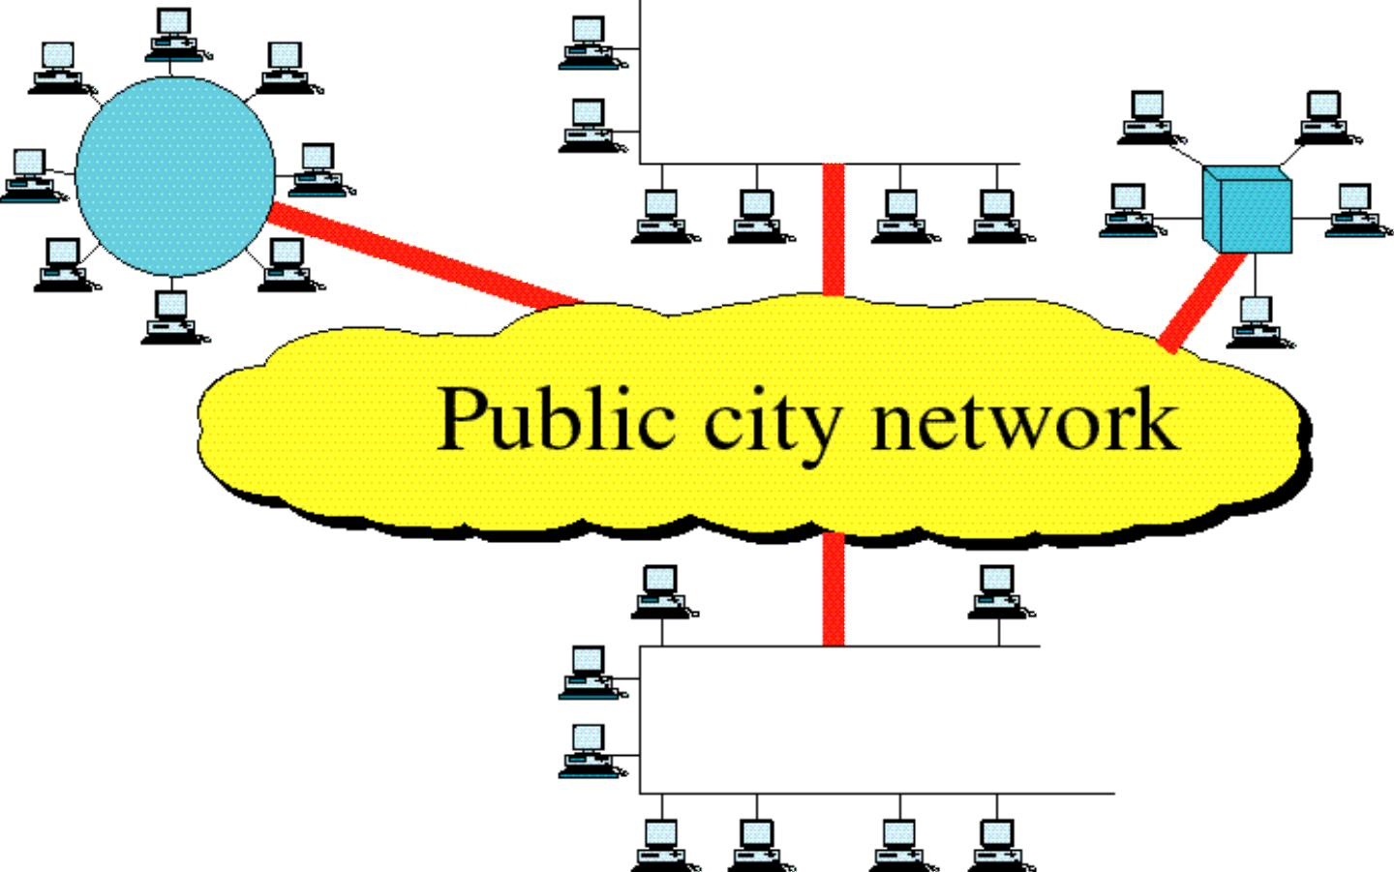
Metropolitan Area Network

Slide 50
Wide Area Network (WAN)
WAN generally cover a large geographical area
A WAN consists of a no. of interconnected switching nodes.
Traditionally, WANs have been implemented using one of technologies:
Circuit switching
Packet switching
More generally- Frame relay and ATM networks(Cell relay) have assumed major roles.
In circuit switching network, a dedicated communication path is established between two stations through the nodes of the network. Ex-telephone network
In packet switching network, data are sent out in a sequence of small chunks called packets. Each packet is passed through the network from node to node along some path leading from source to destination. In this data rate is 64 Kbps.

Slide 51
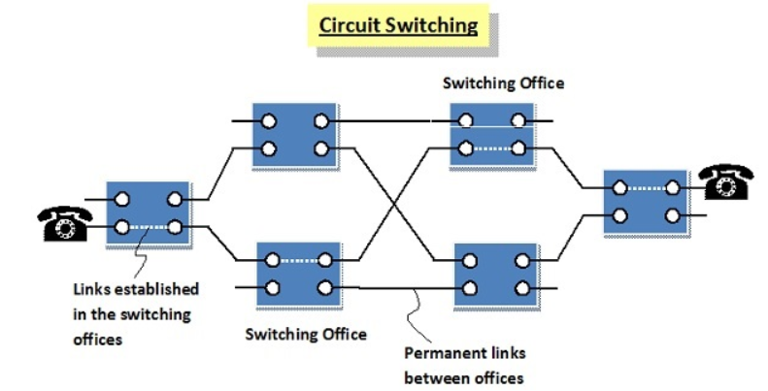
Circuit Switching
In a circuit-switching network, a dedicated communications path is established between two stations through the nodes of the network. That path is a connected sequence of physical links between nodes. On each link, a logical channel is dedicated to the connection. Data generated by the source station are transmitted along the dedicated path as rapidly as possible. At each node, incoming data are routed or switched to the appropriate outgoing channel without delay. The most common example of circuit switching is the telephone network.

Slide 52
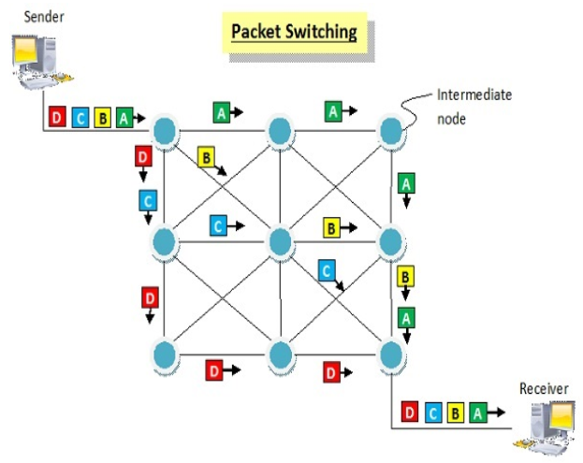
Packet Switching
A quite different approach is used in a packet-switching net-work. In this case, it is not necessary to dedicate transmission capacity along a path through the network. Rather, data are sent out in a sequence of small chunks, called packets. Each packet is passed through the network from node to node along some path leading from source to destination. At each node, the entire packet is received, stored briefly, and then transmitted to the next node. Packet-switching networks are commonly used for terminal-to-computer and computer-to-computer communications.

Slide 53
Wide Area Network (WAN)
Frame relay network was developed to take advantage of high data rates and low error rates.
ATM networks sometimes referred to as Cell relay. It is a culmination of developments in circuit switching and packet switching. The result is ATM is designed to work in the range of 10s and 100s of Mbps and in the Gbps range.
The most difference in between Frame relay and ATM networks is that frame relay uses variable length packets called frames and ATM uses fixed length packets called cells.

Slide 54
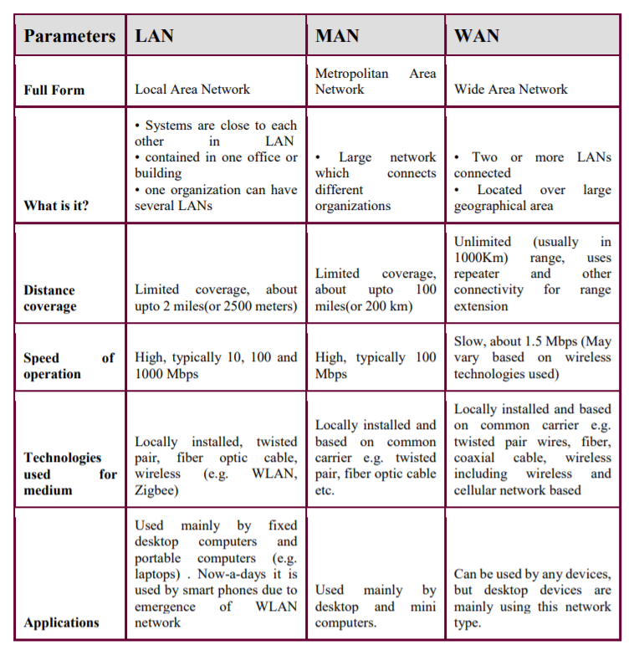
Comparison

Slide 55
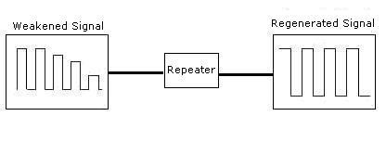
Network Devices
1. Repeater – A repeater operates at the physical layer. Its job is to regenerate the signal over the same network before the signal becomes too weak or corrupted so as to extend the length to which the signal can be transmitted over the same network. An important point to be noted about repeaters is that they do not amplify the signal. When the signal becomes weak, they copy the signal bit by bit and regenerate it at the original strength. It is a 2 port device.

Slide 56
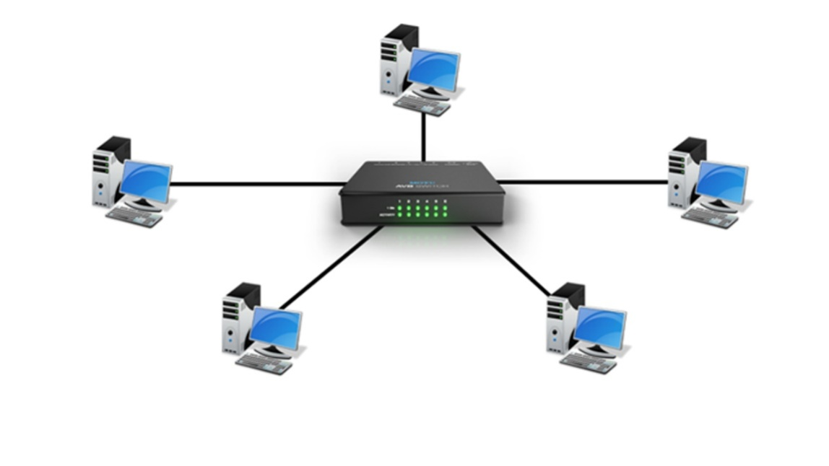
Network Devices
2. Hub – A hub is basically a multiport repeater. A hub connects multiple wires coming from different branches, for example, the connector in star topology which connects different stations. Hubs cannot filter data, so data packets are sent to all connected devices. Also, they do not have intelligence to find out best path for data packets which leads to inefficiencies and wastage.

Slide 57
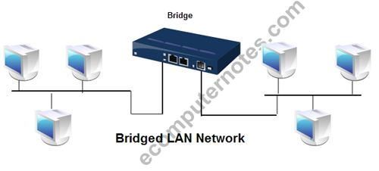
Network Devices
3. Bridge – A bridge operates at data link layer. A bridge is a repeater, with add on the functionality of filtering content by reading the MAC addresses of source and destination. It is also used for interconnecting two LANs working on the same protocol. It has a single input and single output port, thus making it a 2 port device.

Slide 58

Network Devices
4. Switch – A switch is a multiport bridge with a buffer and a design that can boost its efficiency(a large number of ports imply less traffic) and performance. A switch is a data link layer device. The switch can perform error checking before forwarding data, that makes it very efficient as it does not forward packets that have errors and forward good packets selectively to correct port only.

Slide 59
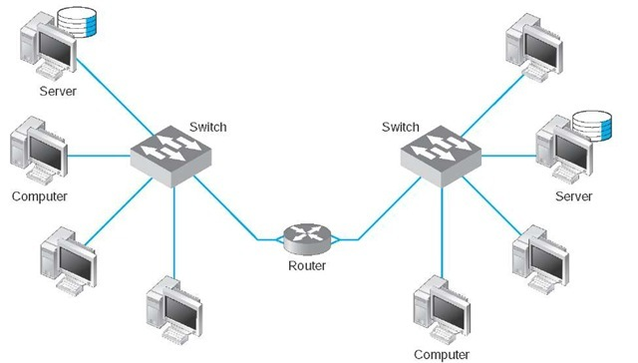
Network Devices
5. Router - A router is a device like a switch that routes data packets based on their IP addresses. Router is mainly a Network Layer device. Routers normally connect LANs and WANs together and have a dynamically updating routing table based on which they make decisions on routing the data packets. Router divide broadcast domains of hosts connected through it.

Slide 60
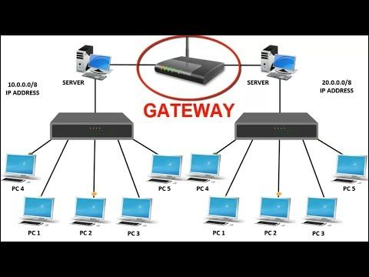
Network Devices
6. Gateway – A gateway, as the name suggests, is a passage to connect two networks together that may work upon different networking models. They basically work as the messenger agents that take data from one system, interpret it, and transfer it to another system. Gateways are also called protocol converters and can operate at any network layer. Gateways are generally more complex than switch or router.

Slide 61
Internet
The Internet evolved from the ARPANET, which was developed in 1969 by the Advanced Research Projects Agency (ARPA) of the U.S. Department of Defense.
It was the first operational packet-switching network. ARPANET began operations in four locations. Today the number of hosts is in the hundreds of millions, the number of users in the billions, and the number of countries participating nearing 200. The number of connections to the Internet continues to grow exponentially.
The purpose of the Internet, is to interconnect end systems, called hosts; these include PCs, workstations, servers, mainframes, and so on.
Most hosts that use the Internet are connected to a network, such as a local area network (LAN) or a wide area net-work (WAN). These networks are in turn connected by routers. Each router attaches to two or more networks. Some hosts, such as mainframes or servers, connect directly to a router rather than through a network.

Slide 62
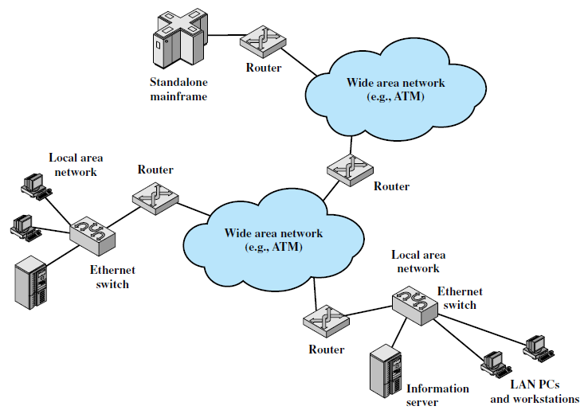
Key elements of internet

Slide 63
Internet operation
A host may send data to another host anywhere on the Internet. The source host breaks the data to be sent into a sequence of packets, called IP datagrams or IP packets.
Each packet includes a unique numeric address of the destination host. This address is referred to as an IP address, because the address is carried in an IP packet.
Based on this destination address, each packet travels through a series of routers and networks from source to destination. Each router, as it receives a packet, makes a routing decision and forwards the packet along its way to the destination.

Slide 64
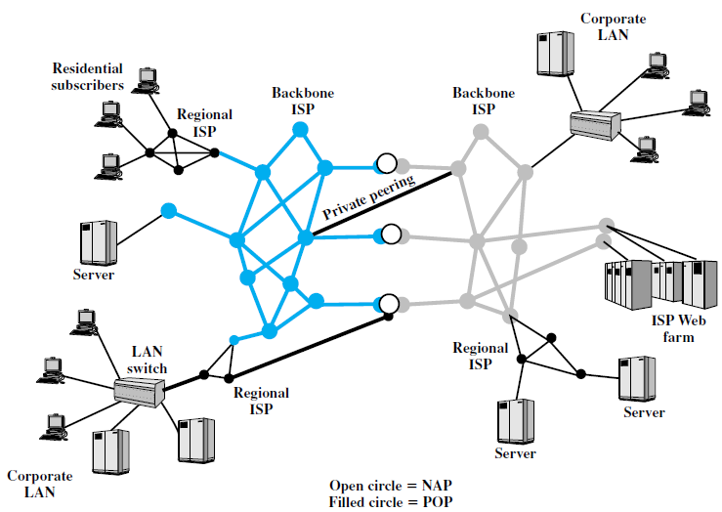
Internet Architecture

Slide 65
Internet
A key element of the Internet is the set of hosts attached to it. Simply put, a host is a computer. Today, computers come in many forms, including mobile phones and even cars. All of these forms can be hosts on the Internet. Hosts are sometimes grouped together in a LAN.
Individual hosts and LANs are connected to an Internet service provider (ISP) through a point of presence (POP). The connection is made in a series of steps starting with the customer premises equipment (CPE). The CPE is the communications equipment located onsite with the host.
Example of CPE is modem

Slide 66
Internet
The CPE is physically attached to the “local loop” or “last mile”. This is the infrastructure between a provider’s installation and the site where the host is located. For example, a home user with a 56K modem attaches the modem to the telephone line. The telephone line is typically a pair of copper wires that runs from the house to a central office (CO) owned and operated by the telephone company.
The local loop is the pair of copper wires running between the home and the CO. Ex: coaxial cables, optical fibers.
The local loop provider is not necessarily the ISP. In many cases the local loop provider is the telephone company and the ISP is a large, national service organization. Often, however, the local loop provider is also the ISP.

Slide 67
Internet
The ISP provides access to its larger network through a POP.
A POP is simply a facility where customers can connect to the ISP network. The facility is sometimes owned by the ISP, but often the ISP leases space from the local loop carrier.
A POP can be as simple as a bank of modems and an access server installed in a rack at the CO. The POPs are usually spread out over the geographic area where the provider offers service. The ISP acts as a gateway to the Internet, providing many important services.
For most home users, the ISP provides the unique numeric IP address needed to communicate with other Internet hosts. Most ISPs also provide name resolution and other essential network services. The most important service an ISP provides, though, is access to other ISP networks. Access is facilitated by formal peering agreements between providers. Physical access can be implemented by connecting POPs from different ISPs. This can be done directly with a local connection if the POPs are collocated or with leased lines when the POPs are not collocated. A more commonly used mechanism is the network access point (NAP).

Slide 68
Internet
A NAP is a physical facility that provides the infrastructure to move data between connected networks.
The networks connected at a NAP are owned and operated by network service providers (NSPs). A NSP can also be an ISP but this is not always the case. Peering agreements are between NSPs and do not include the NAP operator. The NSPs install routers at the NAP and connect them to the NAP infrastructure. The NSP equipment is responsible for routing, and the NAP infrastructure provides the physical access paths between routers.

Slide 69
Internet
Central Office (CO): The place where telephone companies terminate customer lines and locate switching equipment to interconnect those lines with other networks.
Customer Premises Equipment (CPE): Telecommunications equipment that is located on the customer’s premises (physical location) rather than on the provider’s premises or in between. Telephone handsets, modems, cable TV set-top boxes, and digital subscriber line routers are examples.
Internet Service Provider (ISP): A company that provides other companies or individuals with access to, or presence on, the Internet. An ISP has the equipment and the telecommunication line access required to have a POP on the Internet for the geographic area served. The larger ISPs have their own high-speed leased lines so that they are less dependent on the telecommunication providers and can provide better service to their customers.
Network Access Point (NAP): In the United States, a network access point (NAP) is one of several major Internet interconnection points that serve to tie all the ISPs together. Originally, four NAPs—in New York, Washington, D.C., Chicago, and San Francisco—were created and supported by the National Science Foundation as part of the transition from the original U.S. government—financed Internet to a commercially operated Internet. Since that time, several new NAPs have arrived, including WorldCom’s “MAE West” site in San Jose, California and ICS Network Systems’ “Big East.”
The NAPs provide major switching facilities that serve the public in general. Companies apply to use the NAP facilities. Much Internet traffic is handled without involving NAPs, using peering arrangements and interconnections within geographic regions.
Network Service Provider (NSP): A company that provides backbone services to an Internet service provider (ISP). Typically, an ISP connects at a point called an Internet exchange (IX) to a regional ISP that in turn connects to an NSP backbone.
Point of Presence (POP): A site that has a collection of telecommunications equipment, usually refers to ISP or telephone company sites. An ISP POP is the edge of the ISP’s network; connections from users are accepted and authenticated here. An Internet access provider may operate several POPs distributed throughout its area of operation to increase the chance that their subscribers will be able to reach one with a local telephone call. The largest national ISPs have POPs all over the country.

Slide 70
Protocols
A network is a combination of hardware and software that sends data from one location to another. The hardware consists of the physical equipment that carries signals from one point of the network to another. The software consists of instruction sets that make possible the services that we expect from a network
A protocol architecture is the layered structure of hardware and software that supports the exchange of data between systems and supports distributed applications, such as electronic mail and file transfer.
At each layer of a protocol architecture, one or more common protocols are implemented in communicating systems.
A protocol is a set of rules that govern data communications. A protocol defines what is communicated, how it is communicated, and when it is communicated.

Slide 71
Key elements of Protocols
Syntax: The term syntax refers to the structure or format of the data, meaning the order in which they are presented. For example, a simple protocol might expect the first 8 bits of data to be the address of the sender, the second 8 bits to be the address of the receiver, and the rest of the stream to be the message itself.
Semantics: The word semantics refers to the meaning of each section of bits. How is a particular pattern to be interpreted, and what action is to be taken based on that interpretation? For example, does an address identify the route to be taken or the final destination of the message? It includes control information for coordination and error handling.
Timing: The term timing refers to two characteristics: when data should be sent and how fast they can be sent. For example, if a sender produces data at 100 Mbps but the receiver can process data at only 1 Mbps, the transmission will overload the receiver and some data will be lost.

Slide 72
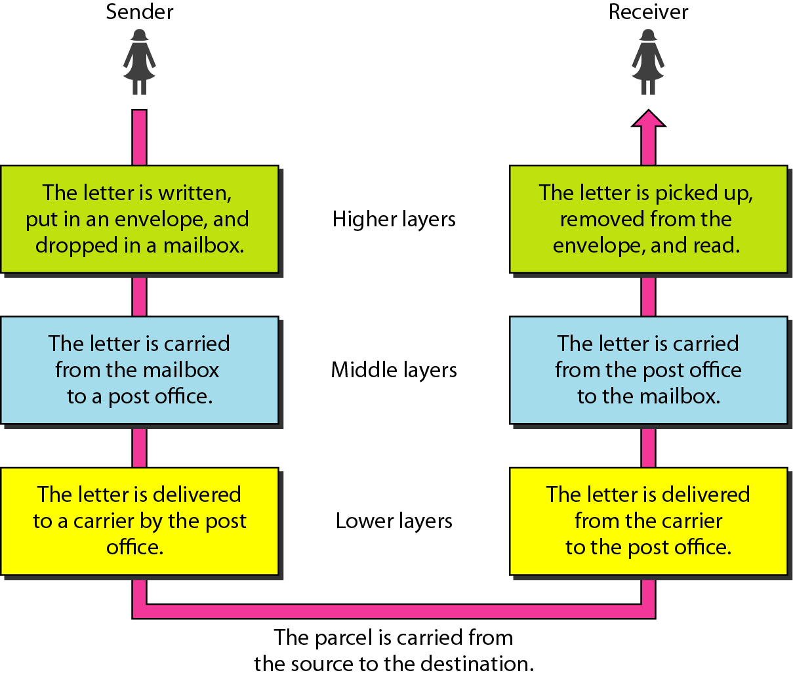
Network Models – Layered Tasks
We use the concept of layers in our daily life. As an example, let us consider two friends who communicate through postal mail. The process of sending a letter to a friend would be complex if there were no services available from the post office.

Slide 73
OSI MODEL
Established in 1947, the International Standards Organization (ISO) is a multinational body dedicated to worldwide agreement on international standards.
An ISO standard that covers all aspects of network communications is the Open Systems Interconnection (OSI) model. It was first introduced in the late 1970s.
An open system is a set of protocols that allows any two different systems to communicate regardless of their underlying architecture.
The purpose of the OSI model is to show how to facilitate communication between different systems without requiring changes to the logic of the underlying hardware and software.
The OSI model is not a protocol; it is a model for understanding and designing a network architecture that is flexible, robust, and interoperable.
Layers 5, 6, 7 are taken care by the operating system and 4, 3, 2, 1 are by network engineer

Slide 74
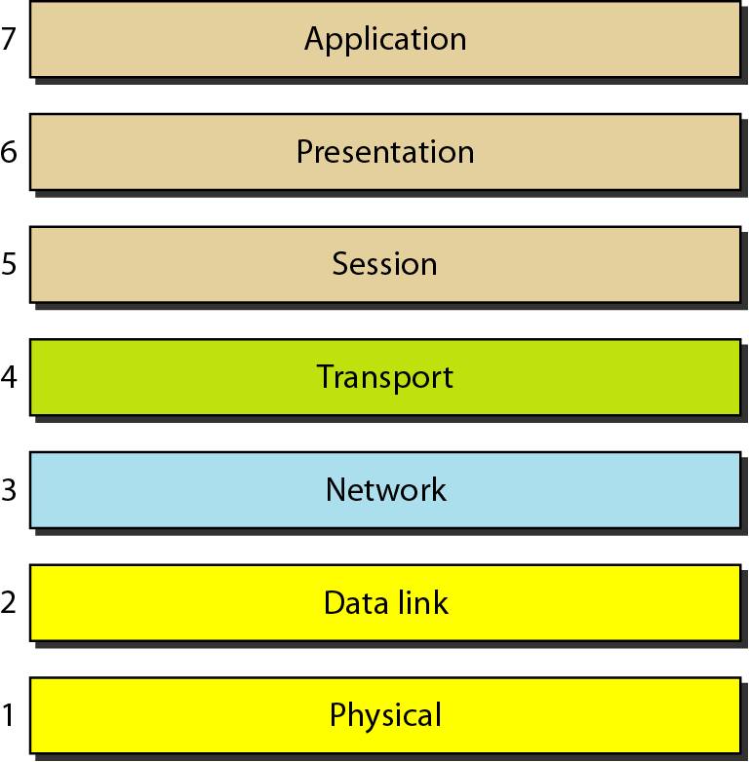
Seven layers of OSI model

Slide 75
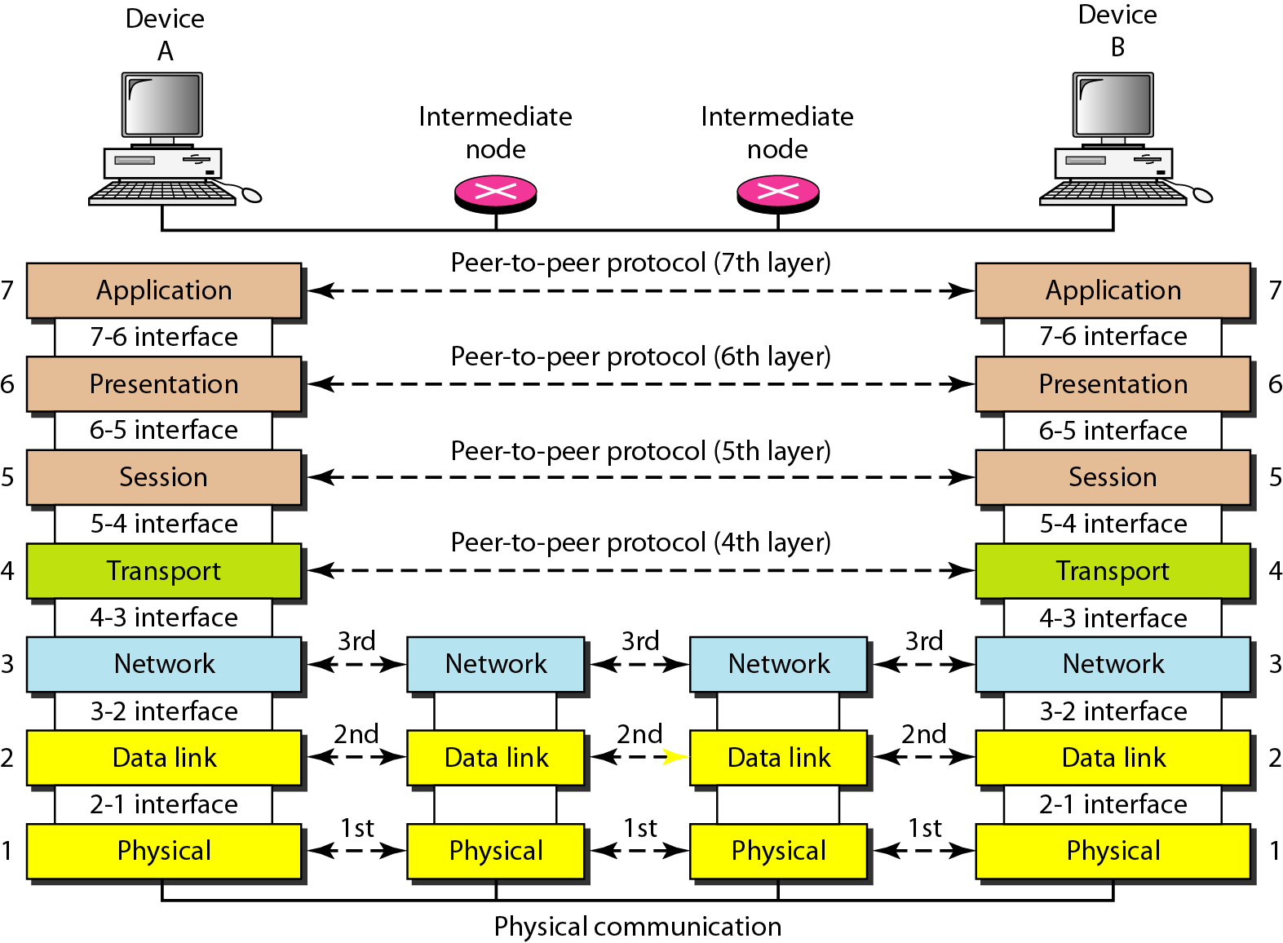
Interaction between layers in the OSI model
Intermediate nodes→ routers
Intermediate nodes→ process the data pertaining to NL,DDL, PL, Application data should not be accessed by router→ attacker

Slide 76
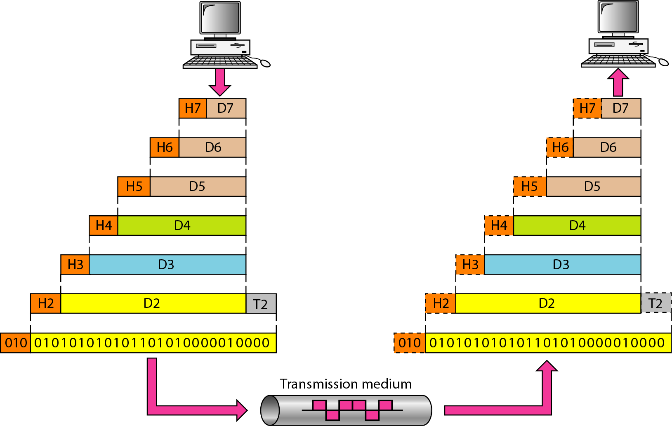
An exchange using the OSI model

Slide 77
Physical Layer
The lowest layer of the OSI reference model is the physical layer.
The physical layer contains information in the form of bits.
It is responsible for transmitting individual bits from one node to the next.
It deals with wires, cables and hardware ports/ connectors
When receiving data, this layer will get the signal received and convert it into 0s and 1s and send them to the Data Link layer, which will put the frame back together.
Ex: If the internet doesn’t work, you will start working or troubleshooting from physical layer

Slide 78
Functions of Physical Layer
Type of transmission media
Type of encoding to be used → how the bits are converted into signals
Data rate
Bit synchronization → clock between the sender and receiver should be the same.
Line configuration
Physical topology
Transmission mode

Slide 79
Data Link Layer
The data link layer is responsible for the node to node delivery of the message.
The main function of this layer is to make sure data transfer is error-free from one node to another, over the physical layer. When a packet arrives in a network, it is the responsibility of DLL to transmit it to the Host using its MAC address.
The packet received from Network layer is further divided into frames depending on the frame size of NIC(Network Interface Card). DLL also encapsulates Sender and Receiver’s MAC ( media access control) address in the header.
MAC address is a hardware address. Every NIC of computer has its own MAC address (Burn- in –address)

Slide 80
Functions of Data Link Layer
Framing: Framing is a function of the data link layer. It provides a way for a sender to transmit a set of bits that are meaningful to the receiver. This can be accomplished by attaching special bit patterns to the beginning and end of the frame.
Physical addressing: After creating frames, Data link layer adds physical addresses (MAC address) of sender and/or receiver in the header of each frame.
Error control: Data link layer provides the mechanism of error control in which it detects and retransmits damaged or lost frames.
Flow Control: The data rate must be constant on both sides else the data may get corrupted thus, flow control coordinates that amount of data that can be sent before receiving acknowledgement.
Access control: When a single communication channel is shared by multiple devices, MAC sub-layer of data link layer helps to determine which device has control over the channel at a given time.

Slide 81
Network Layer
Network layer works for the transmission of data from one host to the other located in different networks. -→original host to destination network
It also takes care of packet routing i.e. selection of the shortest path to transmit the packet, from the number of routes available.
The sender & receiver’s IP address are placed in the header by the network layer.

Slide 82
Functions of Network Layer
Routing: The network layer protocols determine which route is suitable from source to destination. This function of network layer is known as routing.
Logical Addressing: In order to identify each device on internetwork uniquely, network layer defines an addressing scheme. The sender & receiver’s IP address are placed in the header by network layer. Such an address distinguishes each device uniquely and universally.

Slide 83
Transport Layer
Transport layer provides services to application layer and takes services from network layer. The data in the transport layer is referred to as Segments.
It is responsible for the process to process Delivery of the complete message.
The transport layer also provides the acknowledgement of the successful data transmission and re-transmits the data if an error is found.
At sender’s side: Transport layer receives the formatted data from the upper layers, performs Segmentation and also implements Flow & Error control to ensure proper data transmission. It also adds Source and Destination port number in its header and forwards the segmented data to the Network Layer. The sender need to know the port number associated with the receiver’s application. Generally, this destination port number is configured, either by default or manually.
For example, when a web application makes a request to a web server, it typically uses port number 80, because this is the default port assigned to web applications. Many applications have default port assigned.
At receiver’s side: Transport Layer reads the port number from its header and forwards the Data which it has received to the respective application. It also performs sequencing and reassembling of the segmented data.

Slide 84
Functions of Transport Layer
Segmentation and Reassembly: This layer accepts the message from the (session) layer, breaks the message into smaller units . Each of the segment produced has a header associated with it. The transport layer at the destination station reassembles the message.
Service Point Addressing: In order to deliver the message to correct process, transport layer header includes a type of address called service point address or port address. Thus by specifying this address, transport layer makes sure that the message is delivered to the correct process.
Port number → used to identify which application this information is coming from. Ex. Web server has port no of 80 so socket is 10.10.10.10.80 is created and sends to NL.

Slide 85
The services provided by the transport layer
Connection Oriented Service: It is a three-phase process which include – Connection Establishment – Data Transfer – Termination / disconnection In this type of transmission, the receiving device sends an acknowledgement, back to the source after a packet or group of packet is received. This type of transmission is reliable and secure.
Connection less service: It is a one-phase process and includes Data Transfer. In this type of transmission, the receiver does not acknowledge receipt of a packet. This approach allows for much faster communication between devices. Connection-oriented service is more reliable than connectionless Service.

Slide 86
Session Layer
This layer is responsible for establishment of connection, maintenance of sessions, authentication and also ensures security.
It creates, maintains and synchronizes the interaction among communicating devices.

Slide 87
Functions of Session Layer
Session establishment, maintenance and termination: The layer allows the two processes to establish, use and terminate a connection.
Synchronization : This layer allows a process to add checkpoints which are considered as synchronization points into the data. These synchronization point help to identify the error so that the data is re-synchronized properly, and ends of the messages are not cut prematurely and data loss is avoided. For example, if a system is sending a file of 2000 pages, it is advisable to insert checkpoints after every 100 pages to ensure that each 100-page unit is received and acknowledged independently. In this case, if a crash happens during the transmission of page 523, the only pages that need to be resent after system recovery are pages 501 to 523. Pages previous to 501 need not be resent.
Dialog Controller : The session layer allows two systems to start communication with each other in half-duplex or full-duplex.

Slide 88
Presentation Layer
Presentation layer is also called the Translation layer. The data from the application layer is extracted here and manipulated as per the required format to transmit over the network.
It deals with the syntax and semantics of the information exchanged between two systems.
Takes the data converts into the presentable form and gives it to AL

Slide 89
Functions of Presentation Layer
Translation : The processes (running programs) in two systems are usually exchanging information in the form of character strings, numbers, and so on. The information must be changed to bit streams before being transmitted. Because different computers use different encoding systems, the presentation layer is responsible for interoperability between these different encoding methods. The presentation layer at the sender changes the information from its sender-dependent format into a common format. The presentation layer at the receiving machine changes the common format into its receiver-dependent format. For example, ASCII to EBCDIC.
Encryption/ Decryption : Data encryption translates the data into another form or code. The encrypted data is known as the cipher text and the decrypted data is known as plain text. A key value is used for encrypting as well as decrypting data.
Compression: Reduces the number of bits that need to be transmitted on the network. Useful for audio, video

Slide 90
Application Layer
At the very top of the OSI Reference Model stack of layers, we find Application layer which is implemented by the network applications.
These applications produce the data, which has to be transferred over the network.
The application layer enables the user, whether human or software, to access the network.
It provides user interfaces and support for services such as electronic mail, remote file access and transfer, shared database management, and other types of distributed information services.
This layer also serves as a window for the application services to access the network and for displaying the received information to the user.
It enables the user to access the network.
Protocols that works with this layer are FTP, TFTP, SNMP, DNS, HTTP etc

Slide 91
Functions of Application Layer
Network virtual terminal: A network virtual terminal is a software version of a physical terminal, and it allows a user to log on to a remote host. To do so, the application creates a software emulation of a terminal at the remote host. The user's computer talks to the software terminal which, in turn, talks to the host, and vice versa. The remote host believes it is communicating with one of its own terminals and allows the user to log on.
File transfer, access, and management: This application allows a user to access files in a remote host (to make changes or read data), to retrieve files from a remote computer for use in the local computer, and to manage or control files in a remote computer locally.
Mail services: This application provides the basis for e-mail forwarding and storage.
Directory services: This application provides distributed database sources and access for global information about various objects and services.

Slide 92
OSI model
Any change in one layer will not affect the adjacent layer as long as the standard is followed.
Ex. PL → instead of Ethernet cable if wireless is used , it doesn’t matter
NL → IPv4 to IPv6
TL wait until it gets all the segments then it strip all the TL headers and combine that info to the upper layer

Slide 93
Summary of OSI model
Application → network access
Presentation → translate, encrypt, compress
Session → manage session, dialog control and synchronization (check points)
Transport →segment, flow and error control, service point /port addressing
Network →packet, routing, logical add (IP address)
Data link →framing, error, flow and access control, Physical add(MAC)
Physical →transmit bits → transmission media, mode, data rate, line configuration, topology etc.

Slide 94
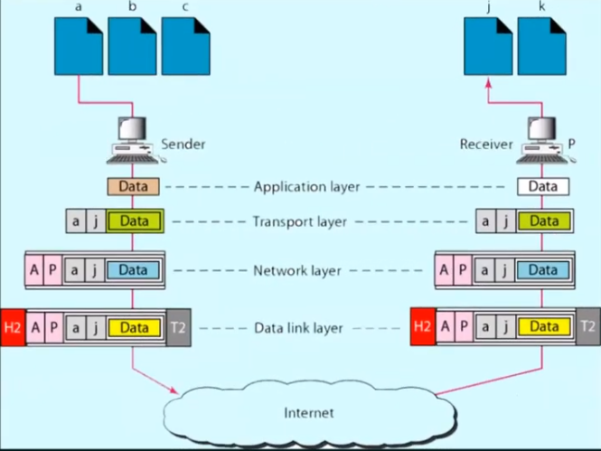
OSI model

Slide 95
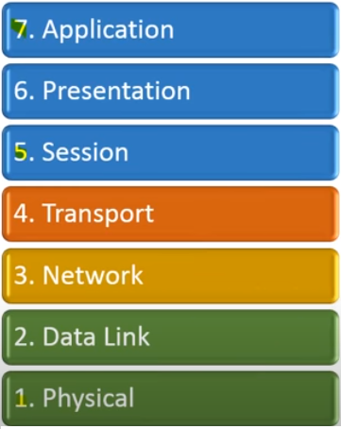
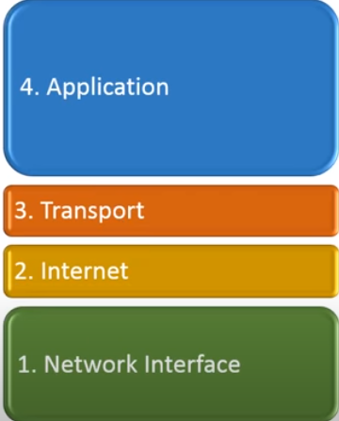
OSI model - TCP/IP model
OSI model
TCP/IP model

Slide 96
TCP/IP model
The OSI Model we just looked at is just a reference/logical model. It was designed to describe the functions of the communication system by dividing the communication procedure into smaller and simpler components.
TCP/IP model was designed and developed by Department of Defense (DoD) in 1960s and is based on standard protocols. It stands for Transmission Control Protocol/Internet Protocol.
The TCP/IP model is a concise version of the OSI model. It contains four layers, unlike seven layers in the OSI model.

Slide 97
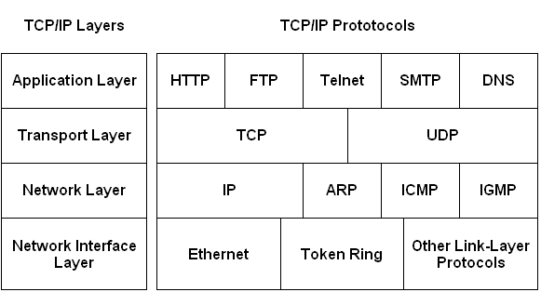
TCP/IP model

Slide 98
TCP/IP model
Network Access Layer
This layer corresponds to the combination of Data Link Layer and Physical Layer of the OSI model.
It looks out for hardware addressing and the protocols present in this layer allows for the physical transmission of data.

Slide 99
TCP/IP model
Internet Layer
This layer parallels the functions of OSI’s Network layer. It defines the protocols which are responsible for logical transmission of data over the entire network. The main protocols residing at this layer are :
IP – stands for Internet Protocol and it is responsible for delivering packets from the source host to the destination host by looking at the IP addresses in the packet headers. IP has 2 versions: IPv4 and IPv6. IPv4 is the one that most of the websites are using currently. But IPv6 is growing as the number of IPv4 addresses are limited in number when compared to the number of users.
Address resolution protocol (ARP) is used to find the physical address of a device whose internet address (IP address) is known.
Reverse Address resolution protocol (RARP): helps to find the internet address of a device whose physical address is known.
Internet Control Message Protocol (ICMP): IP in network layer sends data in form of small packets known as datagrams. ICMP protocol sends the datagrams problems back to sender. It is used for query and error reporting messages.
Internet Group Message Protocol (IGMP): This protocol is used for simultaneous transmission of a message to a group of recipients.

Slide 100
TCP/IP model
Transport layer: Host-to-Host Layer
This layer is analogous to the transport layer of the OSI model. It is responsible for end-to-end communication and error-free delivery of data. It shields the upper-layer applications from the complexities of data. The two main protocols present in this layer are :
Transmission Control Protocol (TCP) – It is known to provide reliable and error-free communication between end systems. It performs sequencing and segmentation of data. It also has acknowledgment feature and controls the flow of the data through flow control mechanism. It is a very effective protocol but has a lot of overhead due to such features. Increased overhead leads to increased cost.
User Datagram Protocol (UDP) – On the other hand does not provide any such features. It is the go-to protocol if your application does not require reliable transport as it is very cost-effective. Unlike TCP, which is connection-oriented protocol, UDP is connectionless.
Stream Control Transmission Protocol (SCTP)
1. This protocol combines the best features of TCP and UDP protocols.
2. It was discovered later to support newer applications such as voice data transmission over the internet.

Slide 101
TCP/IP model
Application Layer
This layer performs the functions of top three layers of the OSI model: Application, Presentation and Session Layer. It is responsible for node-to-node communication and controls user-interface specifications.
HTTP: HTTP stands for Hypertext transfer protocol, it allows the user to interact with world wide web through the browser application. HTTP can be used to transfer various types of data such as plain text, audio, video etc.
FTP: FTP stands for File Transfer Protocol. This protocol is used for transmitting files from one system to another system.
TELNET: TELNET is a client-server protocol. It is a reliable connection oriented protocol. This protocol is used on internet or on LAN to provide a bidirectional (both ways) text based communication through a virtual terminal connection.
DNS: DNS stands for Domain Name System. Each computer on a network has different IP address, a computer is known by its IP address. DNS provides a mapping to a name to the IP Address so a name can be used to identify a system on network rather than IP address itself.
SNMP: SNMP stands for Simple Network Management Protocol. It managers the devices connected to the internet using TCP/IP protocol.
SMTP: SMTP stands for Simple mail transfer protocol. It is used for email services, using this protocol a email containing data can be sent to another email address.

Slide 102
TCP/IP model
TCP/IP protocol suite was actually developed prior to the OSI model → layers don’t exactly match.
The functionalities of PL and DLL are combined into network access layer
The functionalities of SL, PL, AL are merged into single layer called AL.

Slide 103
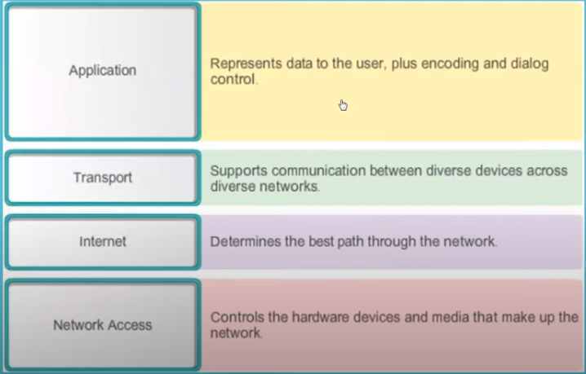
TCP/IP model

Slide 104
Comparison between TCP/IP and OSI model
TCP/ IP | OSI
TCP refers to Transmission Control Protocol. | OSI refers to Open Systems Interconnection.
TCP/IP has 5 layers. | OSI has 7 layers.
TCP/IP is more reliable | OSI is less reliable
TCP/IP does not have very strict boundaries. | OSI has strict boundaries
TCP/IP follow a horizontal approach. | OSI follows a vertical approach.
TCP/IP uses both session and presentation layer in the application layer itself. | OSI uses different session and presentation layers.
TCP/IP developed protocols then model. | OSI developed model then protocol.
Transport layer in TCP/IP does not provide assurance delivery of packets. | In OSI model, transport layer provides assurance delivery of packets.
TCP/IP model network layer only provides connection less services. | Connection less and connection oriented both services are provided by network layer in OSI model.
Protocols cannot be replaced easily in TCP/IP model. | While in OSI model, Protocols are better covered and is easy to replace with the change in technology.

Slide 105
Thank you

